Slide 1
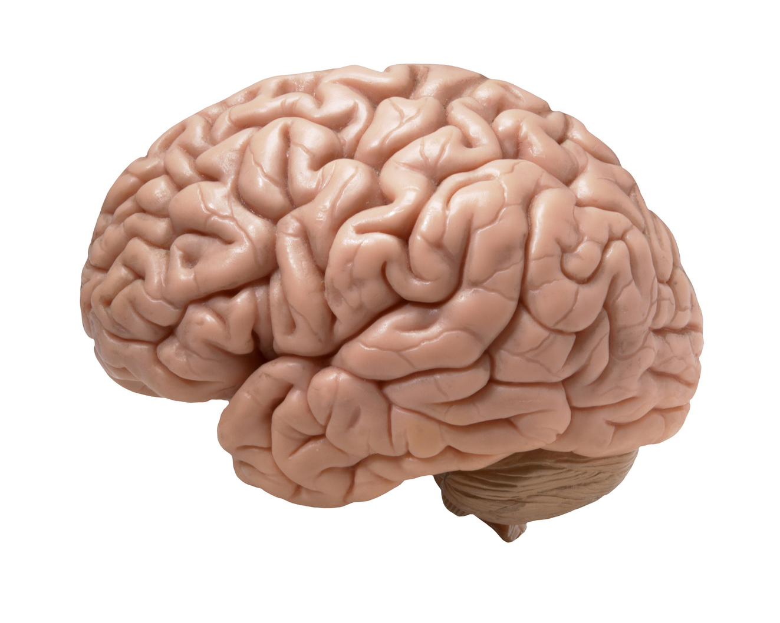
The Brain

Slide 2
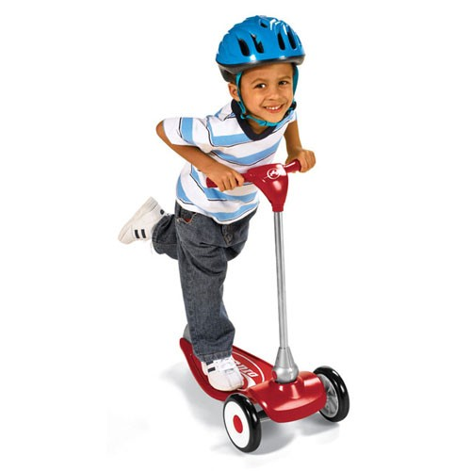
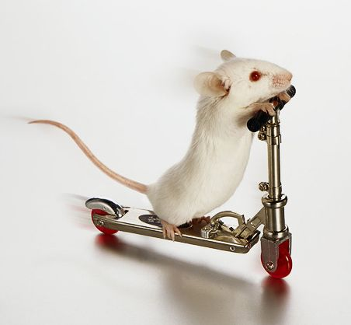
So what can our brains do?

Slide 3
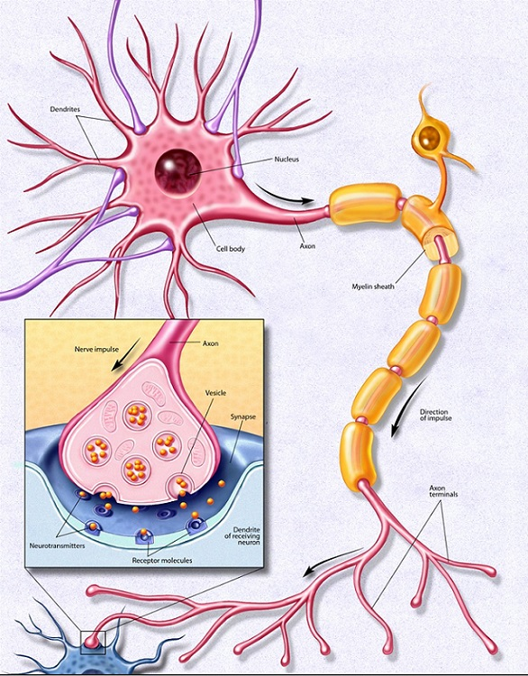
What is the brain made of?
Fancy cells called neurons
They use electric signals to communicate to each other

Slide 4
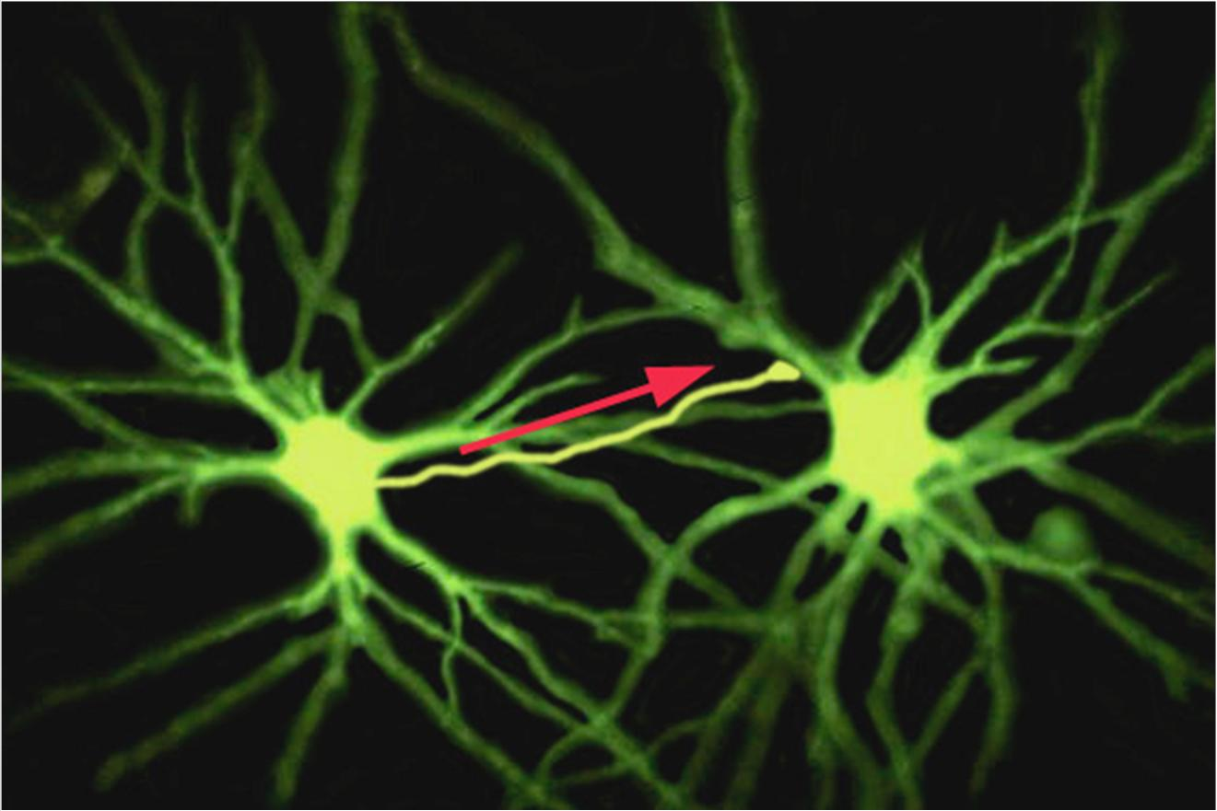
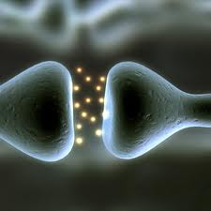

Slide 5
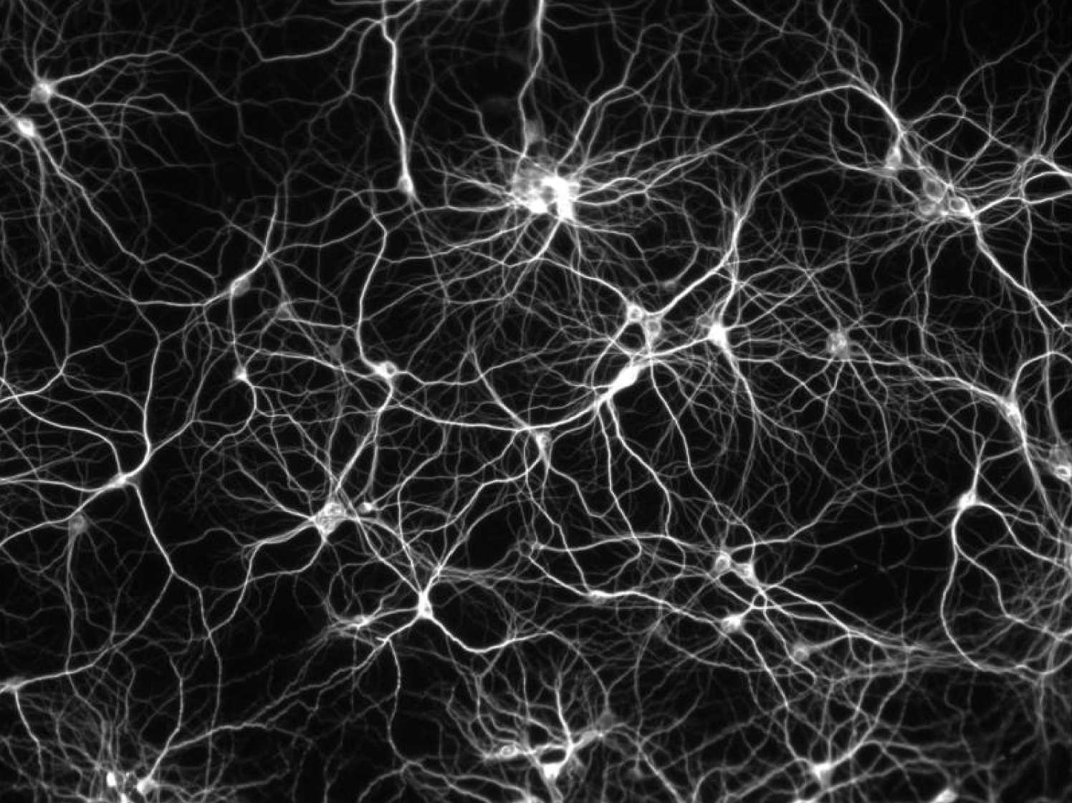
How many neurons do you think are in the brain?
10,000
1,000,000
100,000,000
100,000,000,000
1,000,000,000

Slide 6
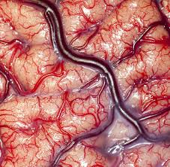
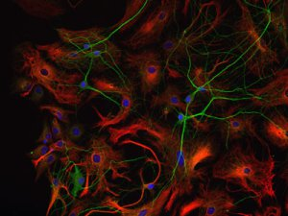
But there’s more!
The brain is also made up of lots of glial cells…
…and lots of blood vessels!

Slide 7
What do the different parts of the brain do?
Each section of the brain has a specific job
Some areas are specialized to do just one thing, like to see or to smell
Other areas get information from all over and combine it into one message

Slide 8
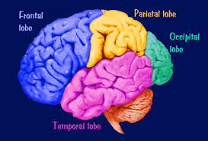

Slide 9
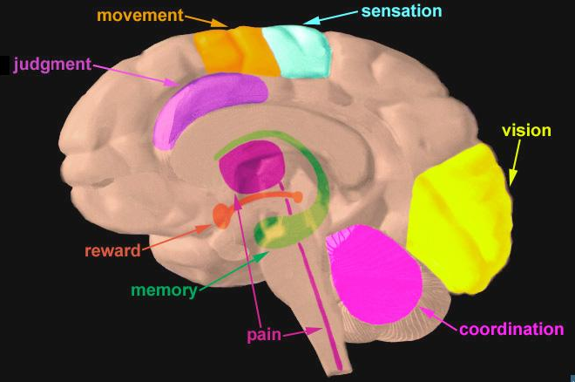
Each area of the brain has a job

Slide 10
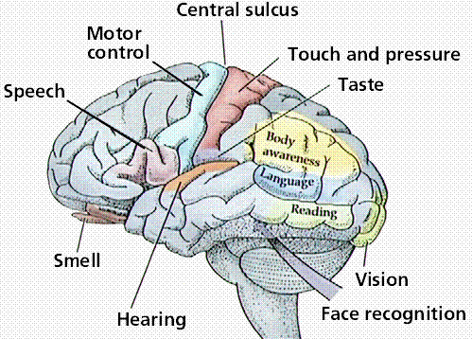
Each of the 5 senses has its place in the brain
Taste
Smell
Hearing
Vision
Touch

Slide 11
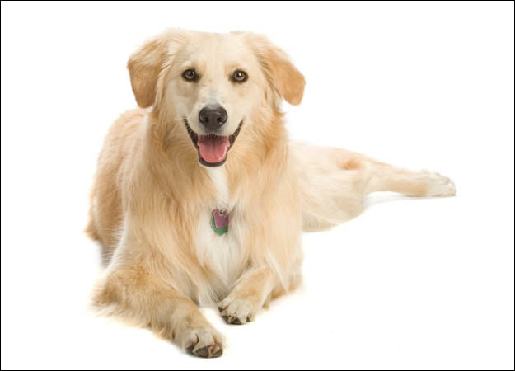
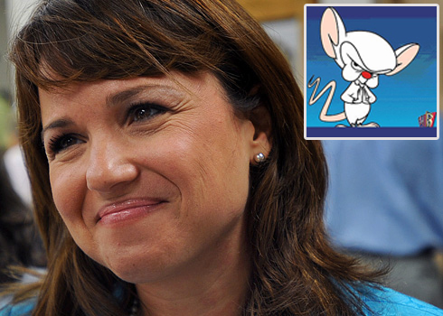
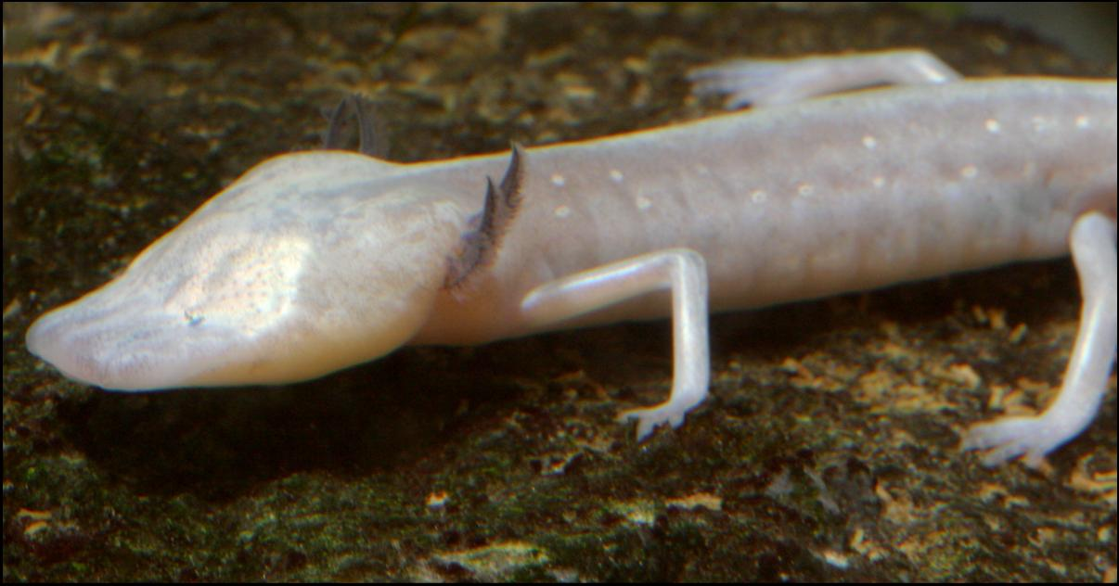
Q: Which of the senses is most important?
A: It depends on who you are!
Taste
Smell
Hearing
Vision
Touch
…but why?

Slide 12
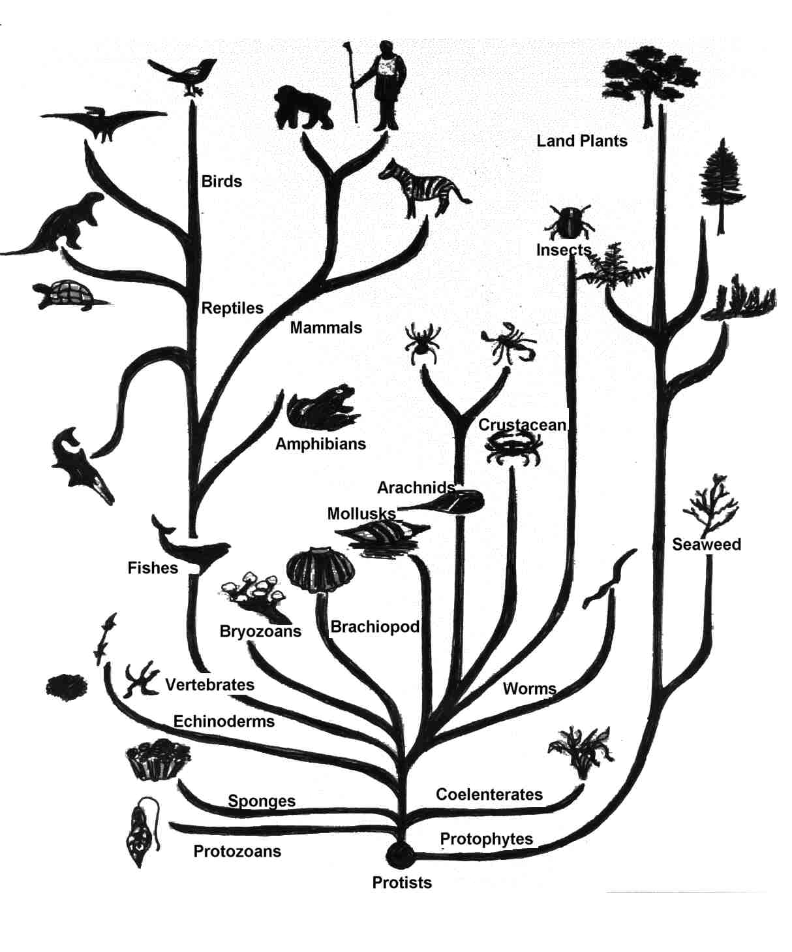
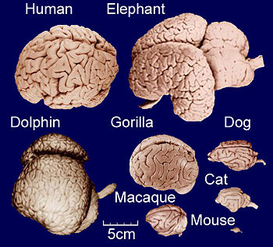
Evolution: As organisms evolve, so do their brains
And your brain controls your senses

Slide 13
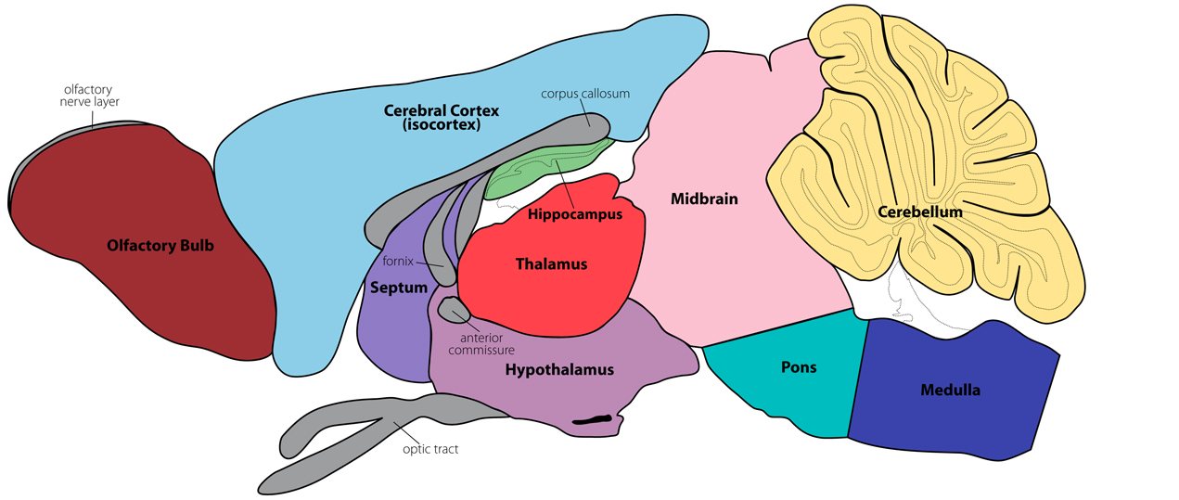
Smell
The sense of smell is not very developed in humans compared with other animals
Can you identify the par of the brain that’s different?
Notes:
Food tastes different with a cold because you can’t smell it

Slide 14
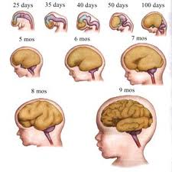
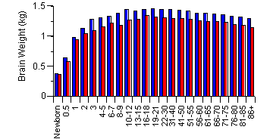
Q: Does your brain grow with you?
A: YES!

Slide 15
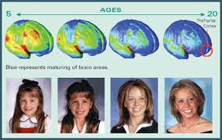
Q: Do our brains change when we learn?
A: YES!!!!

Slide 16
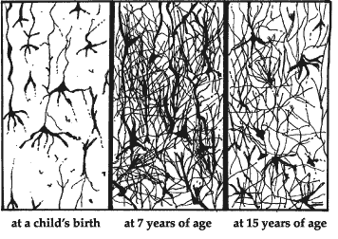
How can a brain change? Synapses!
Q: …but why would we lose synapses when we learn?

Slide 17
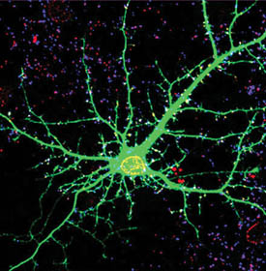
A: Survival of the fittest
A synapse is strengthened when you learn
The synapses that are most important become stronger, and the ones that are weaker are pruned away

Slide 18
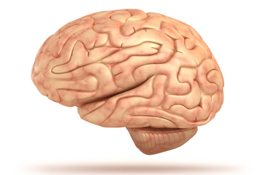

Slide 19
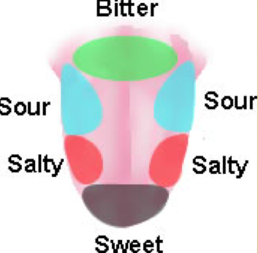
Taste
Notes:
Each person has 5,000-10,ooo taste buds

Slide 20
Smell
The sense of smell is not very developed in humans compared with other animals
Notes:
Food tastes different with a cold because you can’t smell it

Slide 21
Hearing
Why do we need two ears?

Slide 22
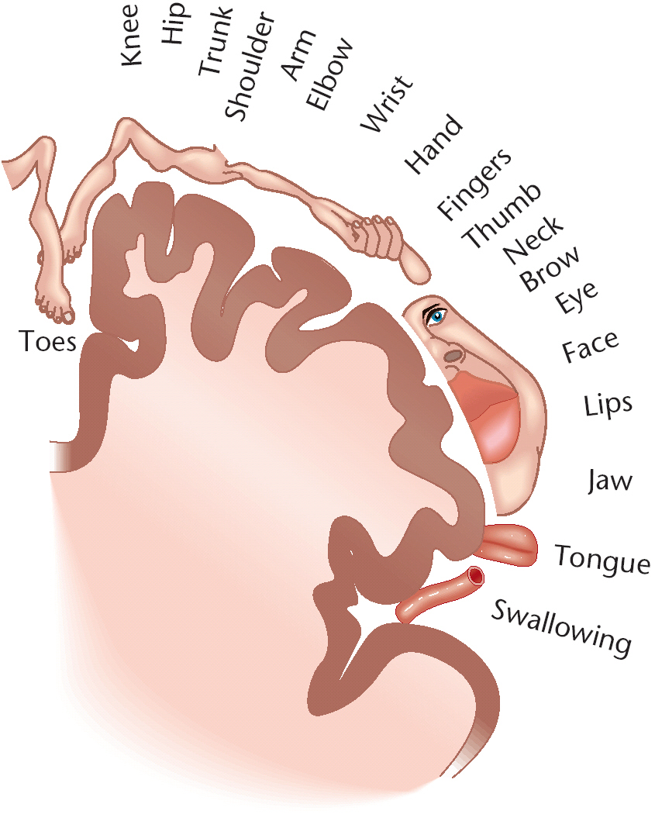
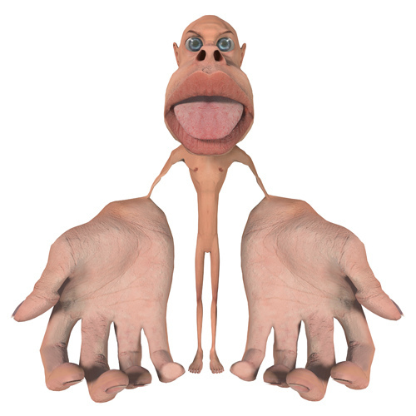
Touch
Every place on your body has a corresponding place in the brain

Slide 23
Vision

Slide 24
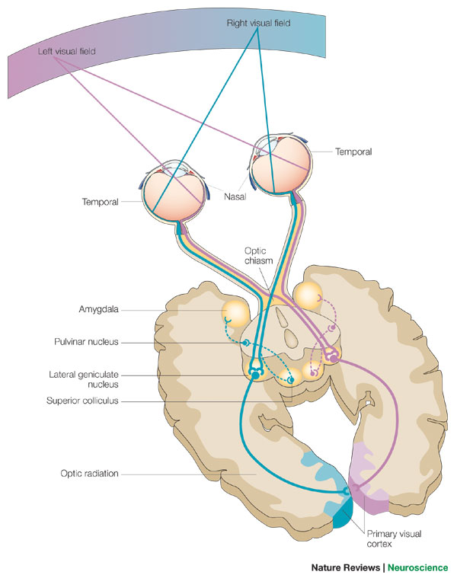

Slide 25
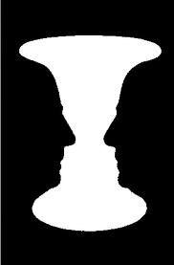

Slide 26
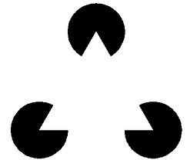

Slide 27
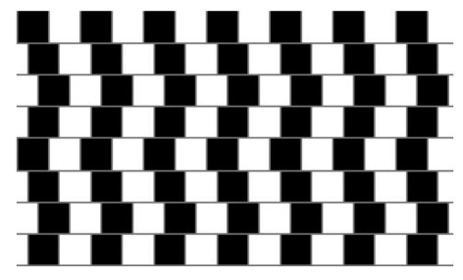

Slide 28
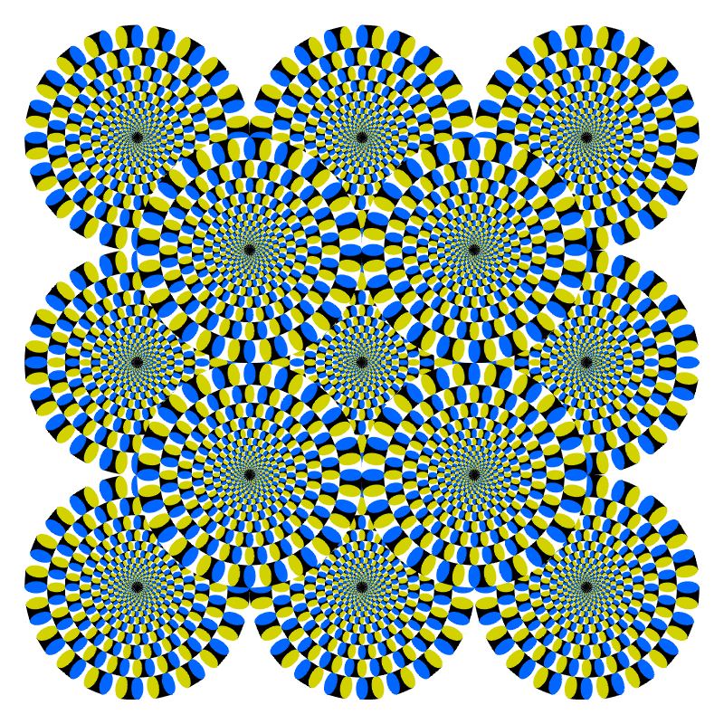

Slide 29
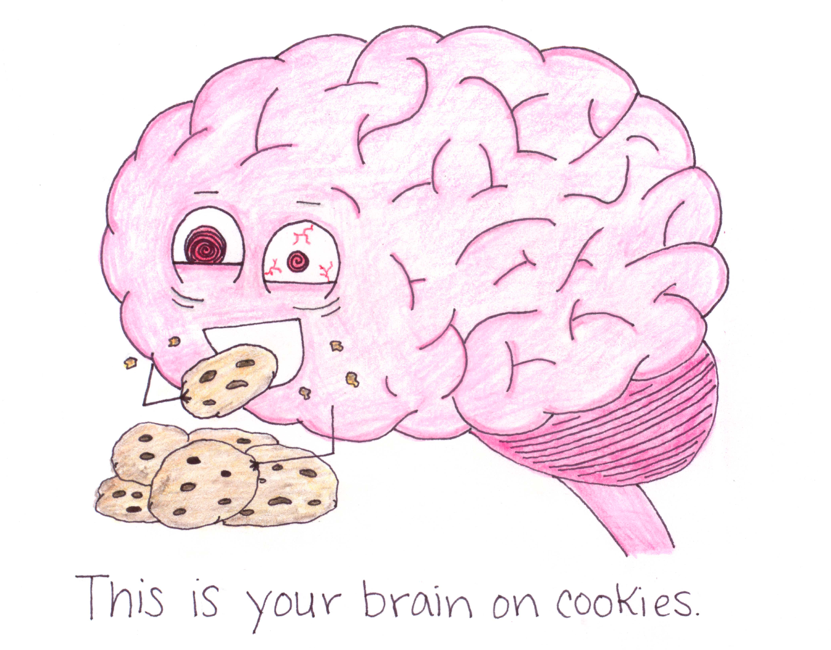
Protect your brain!
Now that you know all about the brain, how can you protect yours?
Wear your seatbelt!
Wear a helmet!
Get lots of sleep!
Exercise and Nutrition!
Use your brain!

Slide 30
Thank you!!
Now who has questions???

Slide 31
The Brain is Responsible for Learning and Memory

Slide 32
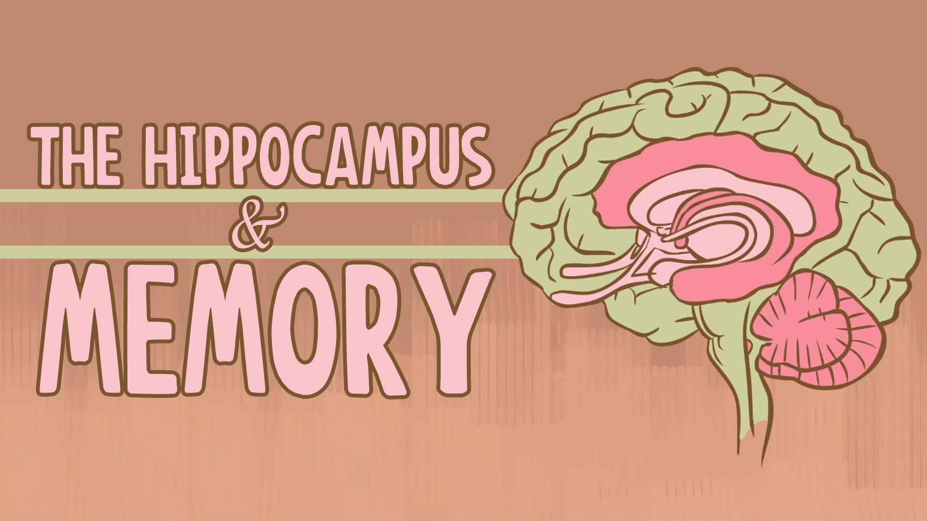

Slide 33
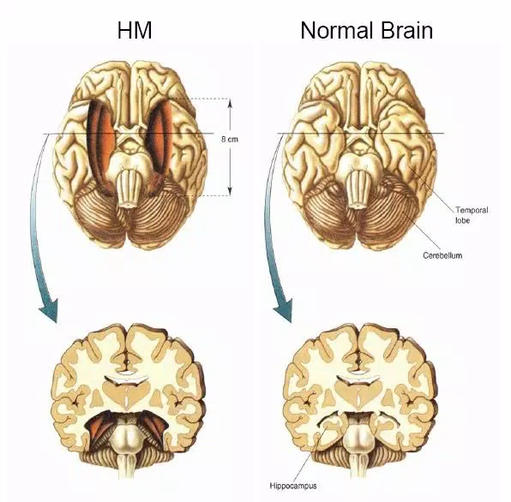

Slide 34
After the Surgery….
Couldn’t form new memories
Remembered his childhood perfectly
Showed that this area of the brain is responsible for learning and retaining memories
Hippocampus

Slide 35
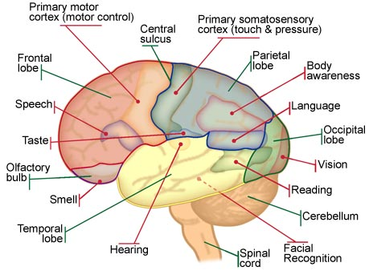

Slide 36
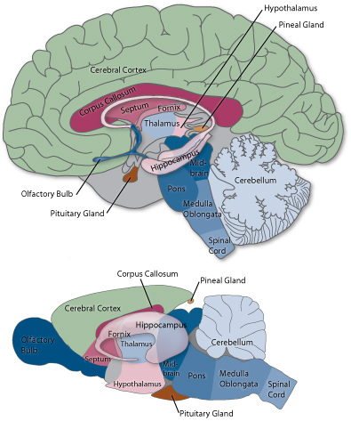
We both have the same brain parts, so what’s different between a human and a mouse?
50-100 billion neurons
50-100 million neurons

